Slide 12
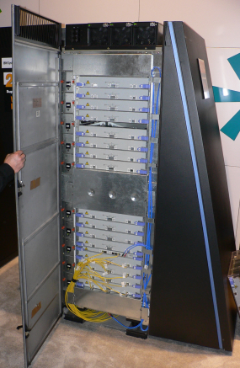

Slide 13
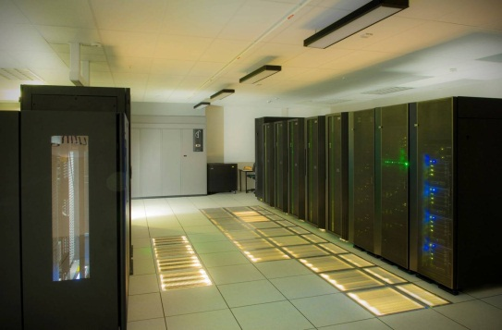
TEXT
TEXT
TEXT
TEXT

